Slide 1

Demystifying Computing with Python
The class will start soon…

Slide 2
Lecture 5-a+b: more Python data structures
Demystifying Computing
with
Python
[‘ap’, ‘ss’, ‘da’, ‘am’]

Slide 3

What will we learn today?
Lecture outcomes:
Tuples and sets
Python packages & Visualizations
Data simulations and random numbers
Visualizations
Lab outcomes:
Data structures use
Tuples and sets
Simulate data sets
Visualizations

Slide 4

Recap Quiz!
colors = ["red", "green", "burnt sienna", "blue"]
What is the output of the colors[2] expression?
Which list index would select the value 'red' from the above list?
What is the result of the “yellow” in colors expression?

Slide 5
Recap Quiz Solution
colors = ["red", "green", “burnt sienna", "blue"]
What is the output of the colors[2] expression? ‘burnt sienna’
Which list index would select the value 'red' from the above list? 0
What is the result of the “yellow” in colors expression? False

Slide 6
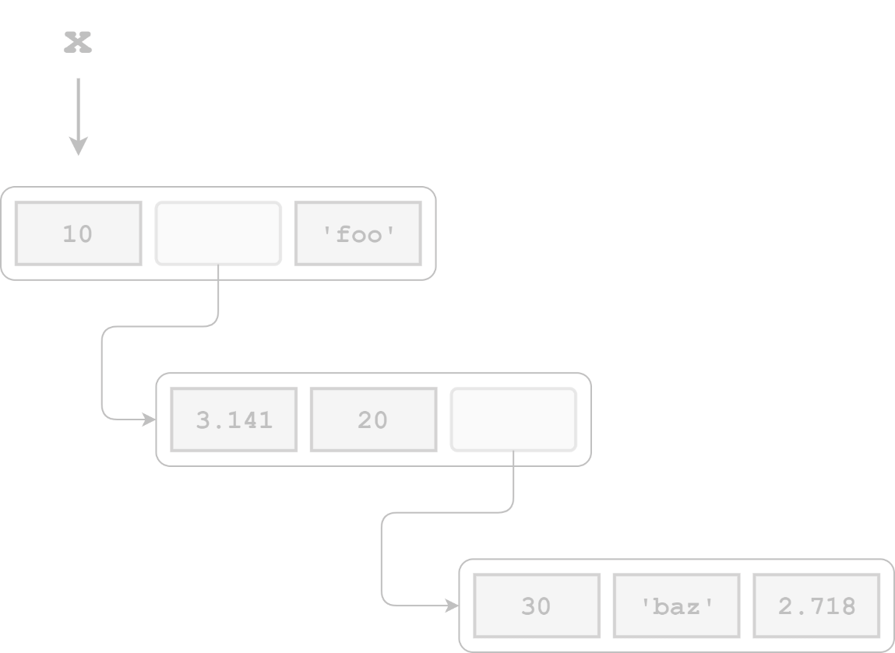
Recap Quiz!
Consider the following nested list (3D) definition:
x = [10, [3.141, 20, [30, 'baz', 2.718]], 'foo’]
What is the expression that returns the 'z' in 'baz’?
What is the expression that returns the ‘f' in foo’?

Slide 7

Recap Quiz Solution
Consider the following nested list definition:
x = [10, [3.141, 20, [30, 'baz', 2.718]], 'foo’]
What is the expression that returns the 'z' in 'baz’?
x[1][2][1][2]
What is the expression that returns the ‘f' in foo’?
x[2][0]

Slide 8
Recap Quiz
Which type of lists or data sets are linear searching algorithms used for?
Unsorted lists or data sets
Sorted lists or data sets
Which type of lists or data sets are binary searching algorithms used for?
Unsorted lists or data sets
Sorted lists or data sets

Slide 9
Recap Quiz Solution
Which type of lists or data sets are linear searching algorithms used for?
Unsorted lists or data sets
Sorted lists or data sets
BOTH
Which type of lists or data sets are binary searching algorithms used for?
Unsorted lists or data sets
Sorted lists or data sets

Slide 10
Recap previous class
A for loop is used for iterating over a sequence
With the while loop we can execute a set of statements as long as a condition is true.
The break statement ends the current loop and jumps to the statement immediately following the loop
i = 1 while i < 6: print(i) i += 1
Whiloops are called le "indefinite loops" because they keep going until a logical condition becomes False

Slide 11
Recap previous class
When a function does not return a value, we call it a "void" function
A function is a block of code.
It is only run when you call it!
You can pass data, known as parameters, into a function.
A function can return data as a result.
def average_of_three(x,y,z):
return (x+y+z)/3
print(average_of_three(10,20,30))
def calc_square(x):
return x**2
print(calc_square(2))

Slide 12
Dictionaries
A dictionary is a collection which is unordered, changeable and indexed.
In Python dictionaries are written with curly brackets, and they have keys and values.
Dictionaries are Python’s most powerful data collection.
Dictionaries allow us to do fast database-like operations in Python.
my_data = { "brand": "Ford", "model": "Mustang", "year": 1964 }

Slide 13
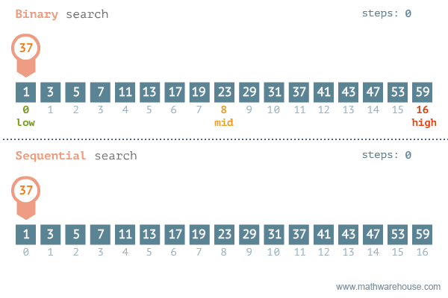
Recap Cont. Binary vs Linear Search

Slide 14
Data Structures
A data structure is a data organization, management, and storage format that enables efficient access and modification [Wikipedia]

Slide 15
Quiz 1!
When I need to store data in the form of “Key-Value”:
I will use ………………………
When I need to store data in the form “Index-Value”:
I will use …………………………

Slide 16
Quiz Solutions!
When I need to store data in the form of “Key-Value”:
I will use ……Dictionaries……….
When I need to store data in the form “Index-Value”:
I will use ……Lists…….

Slide 17
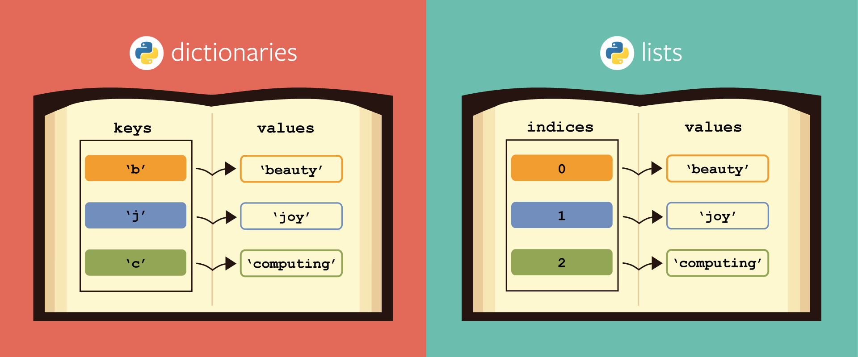
Python Data structures

Slide 18
Sets
Sets are constructed from a sequence.
Sets cannot have duplicated values
There are usually used to build sequence of unique items (e.g., set of identifiers such as IDs etc.).
alist = [“Stelios”, “Tom”, “Tom”, “Stelios”, “Claudia”]
aset = set(alist)
print(list(aset))
# the set includes only the unique elements!
aset = [“Stelios”, “Tom”, “Claudia”]

Slide 19
Sets
a = set([1, 2, 3])
b = set([2, 3, 4])
a.intersection(b)
# This will return
set([2, 3])
c = a.intersection(b)
c.issubset(a)
# This will return
True
c.issubset(a)
# This will return
False
Ideal when we need to remove duplicated values
Also ideal for doing logic operations
a.difference(b)
# This will return
set([1,4])
Duplicates are
eliminated

Slide 20
Sets
a = set([1, 2, 3,4])
b = set([3,4,5,6])
a.intersection(b)
# This will return
set([3, 4])
c = a.intersection(b)
c.issubset(a)
# This will return
True
a.issubset(b)
# This will return
False
Ideal when we need to remove duplicated values
Also ideal for doing logic operations
a.difference(b)
# This will return
set([1,2,5,6])
Duplicates are
eliminated

Slide 21
Sets: Basic operations
Create an empty set
Iterate over a set and print elements
#Create a new empty set
empty_set = set()
#Create a non empty set
aset = set([0, 1, 2, 3, 4])
#Create a set
num_set = set([0, 1, 2, 3, 4, 5])
for element in num_set:
print(element)

Slide 22
Sets: Basic operations cont
Add data to a set
Remove data from a set
color_set = set() # alist = list() or alist = [] EMPTY!
color_set.add("Red")
#Add multiple items
color_set.update(["Blue", "Green"])
color_set.pop()
# Will remove the last element

Slide 23
Sets: Basic operations cont
Intersection of two sets
Union of two sets
x = set(["green", "blue"])
y = set(["blue", "yellow"])
z = x & y # or x.intersection(y)
“blue”
x = set(["green", "blue"])
y = set(["blue", "yellow"])
z = x | y # or x.union(y)
”green”,”blue”,”yellow”

Slide 24
Sets: Basic operations cont
Len of a set (similar to lists)
x = set(["green", "blue"])
# len(x) -> will print 2

Slide 25
Quiz 2!
Sets allow duplicated values:
True or False?
Sets have no order in data:
True or False?
Sets do no support indexing:
True or False?

Slide 26
Quiz Solutions!
Sets allow duplicated values:
False
Sets have no order in data:
True
Sets do no support indexing:
True

Slide 27
Facts about Sets
SETS do not Support indexing
Duplicates are
eliminated
SETS are ideal For Boolean operations
SETS have
no order

Slide 28
Quiz 3!
x = set([“Agatha Christie ", “J.R.R Tolkien"])
y = set(["J.R.R Tolkien ", “Virginia Woolf"])
z = set([" J.R.R Tolkien "])
issubset1 = x.issubset(y)
print(issubset1)
issuperset2 = y. issuperset(x)
print(issuperset2)
issubset3 = z.issubset(y)
print(issubset3)
issuperset4= y.issuperset(z)
print(issuperset4)
What is the output of the print statements?

Slide 29
Quiz 3!
x = set([“Agatha Christie ", “J.R.R Tolkien"])
y = set(["J.R.R Tolkien ", “Virginia Woolf"])
z = set([" J.R.R Tolkien "])
issubset1 = x.issubset(y)
print(issubset1)
issuperset2 = y. issuperset(x)
print(issuperset2)
issubset3 = z.issubset(y)
print(issubset3)
issuperset4= y.issuperset(z)
print(issuperset4)
Will it print True or False?

Slide 30
Quiz 3 Solutions!
x = set([“Agatha Christie ", “J.R.R Tolkien"])
y = set(["J.R.R Tolkien ", “Virginia Woolf"])
z = set([" J.R.R Tolkien "])
issubset1 = x <= y
print(issubset1) # This will print False
issuperset2 = x >= y
print(issuperset2) # This will print False
issubset3 = z <= y
print(issubset3) # This will print True
issuperset4 = y >= z
print(issuperset4) # This will print True
The outputs of the print statements are True or False?

Slide 31
More Python data structures
Tuples:
A data structure very similar to the list data structure.
The main difference being that tuple manipulation are faster than list because tuples are
IMMUTABLE
mytuple = (10, 20, 30)
mytuple[0]
#Will print
mytuple = (10, 20, 30)

Slide 32
Tuples
Tuples are optimised!
This makes them very simple.
There are two functions available only:
index, to find the occurrence of a value
count, to count the number of occurrences of a value
Tuples are useful because there are
faster than lists
protect the data, which is immutable
tuples can be used as keys on dictionaries
my_protected_dictionary = dict([('jan', 1), ('feb', 2), ('march', 3)])
my_protected_dictionary['feb’]
# This will print 2!
# The keys are immutable!

Slide 33
Tuples: Useful hints
Tuple unpacking:
data = (1,2,3)
x, y, z = data
# x is 1, y – 2 (will be 0)etc.
len(data)
Will print 3
Slicing works similar to lists
t = (1,2,3,4,5)
t[2:]
(3, 4, 5)

Slide 34
Working with tuples
tuplex = (4, 6, 2, 8, 3, 1)
print(tuplex)
#tuples are immutable!, so you can not add new elements
#using merge of tuples with the + operator you can add an element and it will create a new tuple
tuplex = tuplex + (9,)
print(tuplex)

Slide 35
Working with tuples
tuplex = (4, 6, 2, 8, 3, 1)
listx = list(tuplex)
#Add an item in the list
listx.append(30)
#Make the list tuplex
tuplex = tuple(listx)

Slide 36
Working with tuples
tuplex = (2, 4, 5, 6, 2, 3, 4, 4, 7)
#return the number of times it appears in the tuple.
count = tuplex.count(4)
# This will print 3!

Slide 37
Working with tuples
#Convert list to tuple
listx = [5, 10, 7, 4, 15, 3]
#use the tuple() function built-in Python, passing as parameter the list
tuplex = tuple(listx)

Slide 38
Recap on dictionaries
Store pairs of entries called items
Each pair of entries contains
A key
A value
Keys must be unique within a dictionary
No duplicates
adict = {“id”: [“CS”, “IT”], “Name”: [“Computer Science”, “Information Technology”]}

Slide 39
 | Lists | Sets | Dictionaries | Tuples
Define | alist = [1,2,7] | aset = {1,12,8} aset = set([1,12,8]) | adict ={‘name’:’Stelios’, ‘email’:’s@test.com’} | data=(10,20,30) x,y,z=data
Access | print(alist[0]) | print(aset), cannot print by index! | print(adict[‘name’]) | print(data[0]) or print(x)
Duplicated values? | Yes | No | No duplicated keys, Yes duplicated values | Yes (faster than lists)
Add | alist.append(10) | aset.add(10) | adict[‘city’]=‘London’ | You cannot add directly, indirectly only (transform to list)
Mutable? | Yes | Yes | Yes | No!
Empty data structure | alist=[] or alist=list() | aset=set() | adict={} or adict=dict() | data=() *Useless, you cannot add!
Slicing? | alist[1:2] (by index) | Not available | Not available | Not available
When to use? | Collection of data that does not need random access. When you need to iterate and modify items. | When you want to eliminate duplicated values. When you need uniqueness of elements | You need a key to value data association. Fast lookup, based on a key. When data needs to be modified | To ensure immutability. Can be used in combination with other data structure, for example a tuple could represent a key in a dictionary

Slide 40
 | Lists | Dictionaries | Sets | Tuples
When to use? | Collection of data that does not need random access. When you need to iterate and modify items. | You need a key to value data association. Fast lookup, based on a key. When data needs to be modified | When you want to eliminate duplicated values. When you need uniqueness of elements | To ensure immutability. Can be used in combination with other data structure, for example a tuple could represent a key in a dictionary
Duplicated values? | Yes | No duplicated keys, Yes duplicated values | No | Yes (faster than lists)
Mutable? | Yes | Yes | Yes | No!
Slicing? | alist[0:2] (by index) * Remember index starts from zero | Not available | Not available (you need to create a loop and extract data) | Not available
When to use? | Collection of data that does not need random access. When you need to iterate and modify items. | You need a key to value data association. Fast lookup, based on a key. When data needs to be modified. | When you want to eliminate duplicated values. When you need uniqueness of elements. | To ensure immutability. Can be used in combination with other data structure, for example a tuple could represent a key in a dictionary.

Slide 41
 | Lists | Dictionaries | Sets | Tuples
Create a new | alist = [10,20,30,40] | adict ={‘name’:Tom’, ‘email’:’tom@msn.com’} | aset={10,20,30,40} | atuple=(10,20,30)
Create an empty | alist = list() or alist = [] | adict = dict() or adict = {} | aset=set() | atuple=() *Useless, you cannot add!
Add a value | alist.append(50) This will make: alist = [10,20,30,40,50] | Add a new key/value adict['city']='London’ | aset.add(50) | You cannot add! Indirectly, you need to convert to a list
Remove a value | alist.remove(40) This will make: alist = [10,20,30] | Delete key and value adict.pop(‘email’) | Delete the first element of the set aset.pop() | You cannot delete! Indirectly, you need to convert to a list
Update a value | alist[1] = 200 This will make alist = [10,200,30,40] | adict[‘city’]=‘Athens’ | Best way is to convert to list, update and make it a set again | You cannot update! Indirectly, you need to convert to a list
Access an element | If you want to access element 20, you will use the element index number 0 1 2 3 alist = [10,20,30,40] alist[1] | If you want to access an element by key you use the key adict[‘email’] it will extract the values for key ‘email’ | You have to use a loop to iterate | x,y,z = atuple So x = 10, y =20, z=30 Or index: atuple[
Loops | for element in alist: print(element) | for key,value in adict.items(): print(key,value) | for element in aset: print(element | for element in atuple: print(element) # We prefer to extract using variable
Notes:
fruits = {"apple", "banana", "cherry"}
fruits = list(fruits)
fruits[1]='mantarina'
fruits = set(fruits)
print(fruits)

Slide 42
How often do I use different data structures?
Lists?
Most common
Dictionaries?
Very often, when you need key-value pair data
Sets?
Rarely, very powerful data structure for many problems!
Eliminate duplicated values
Tuples?
When I remember that exist!
Very rarely!

Slide 43
Python modules
Modules:
A file containing a set of functions you want to include in your application.
mymodule.py
def greeting(name): print(“Hi, " + name)
import mymodule
mymodule.greeting(“Tom”)

Slide 44
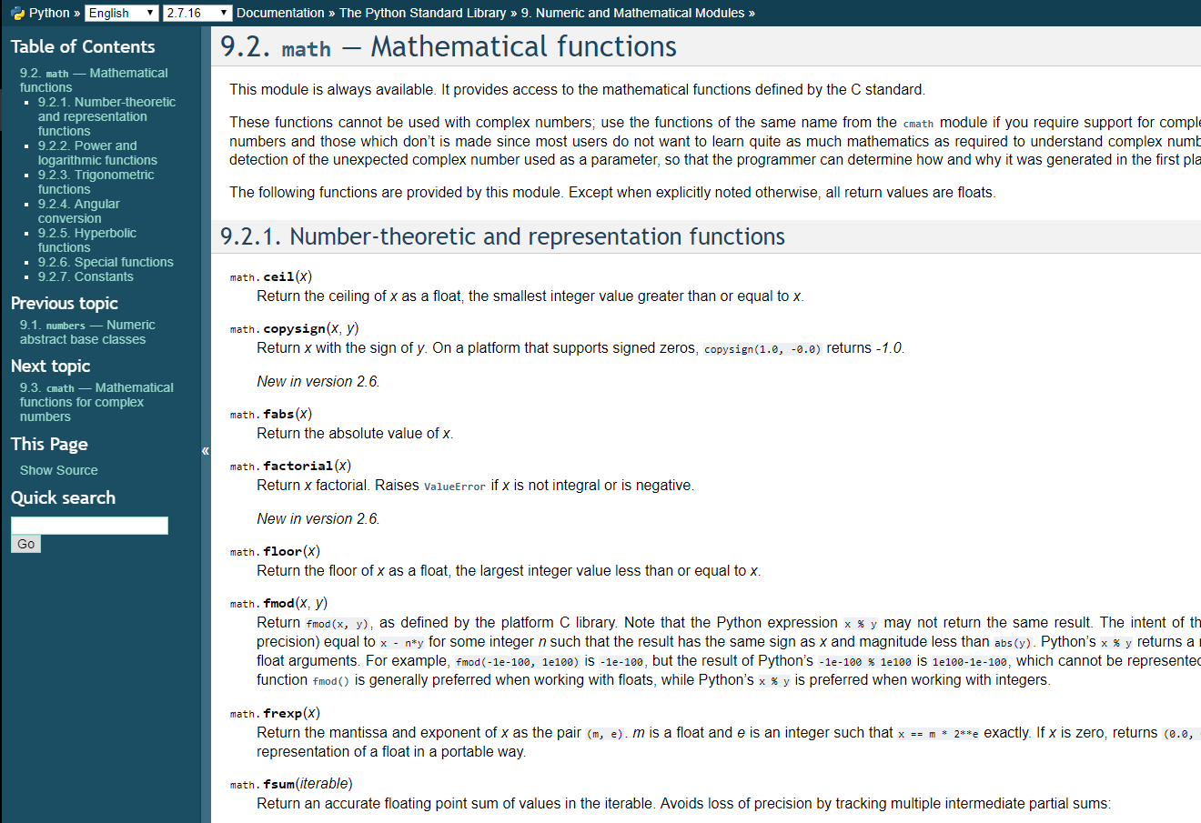
Python modules: math
import math
mynum = 10
print(math.sqrt(mynum))
# This will print 3.16

Slide 45
Random numbers
Why we need random numbers?
Testing!
Generating datasets
Aside from obvious applications like gambling or creating unpredictable scenarios in a computer game, randomness is important for Cryptography.
Cryptography requires numbers that attackers can't guess.

Slide 46
Random numbers
Generate pseudo-random numbers
Python defines a set of functions that are used to generate or manipulate random numbers.
This particular type of functions are used in a lot of games, lotteries or any application requiring random number generation. [GeeksForGeeks]
import random
my_random_num = random.randint(1,10)
print(my_random_num)
print(my_random_num)
print(my_random_num)
# what does it print?
5
5
5

Slide 47
Random numbers, cont’d
import random
r1,r2,r3 = random.randint(1,10), random.randint(1,10), random.randint(1,10)
print(r1)
print(r2)
print(r3)
import random
alist = list()
for i in range(10):
alist.append(random.randint(1,10))
print(alist)
3
2
5
[7, 3, 6, 6, 7, 5, 3, 3, 5, 5]

Slide 48
The random module
from random import *
# Generate a pseudo-random number between 0 and 1.
random()
# Pick a random number between 1 and 100.
randint(1, 100)
# Shuffle the list items
items = [1, 2, 3, 4, 5, 6, 7, 8, 9, 10]
shuffle(items)
print(items)
# Pick 4 random items from the list
y = sample(items, 4)

Slide 49
Seeding random generators
We need to generate numbers
Yet, sometimes its good to generate the same numbers so we can validate results more easily
Use of seed
The seed value is very significant in the field of computer security to pseudo-randomly generate a strong secret encryption key.
So using a custom seed value, we can initialize the strong pseudo-random number generator the way we want.

Slide 50
Random module cont.
import random
random.seed(1)
alist = list() # or []
for i in range(10):
alist.append(random.randint(1,10))
print(alist)
random.seed(2)
alist = list()
for i in range(10):
alist.append(random.randint(1,10))
print(alist)
[3, 10, 2, 5, 2, 8, 8, 8, 7, 4]
[1, 2, 2, 6, 3, 5, 5, 10, 4, 10]
This always prints the same results!

Slide 51
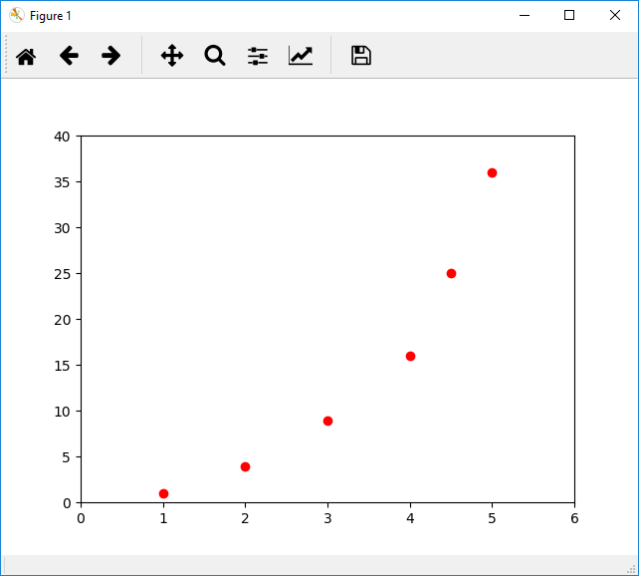
Visualizations
Matplotlib is a Python 2D plotting library which produces publication quality figures in a variety of hardcopy formats and interactive environments across platforms.
[matplotlib]
import matplotlib.pyplot as plt
plt.plot([1,2,3,4,4.5,5], [1,4,9,16,25,36], 'ro')
plt.axis([0, 6, 0, 40])
plt.show()

Slide 52
Matplotlib
import matplotlib.pyplot as plt
Import the library and name it as plt
plt.plot(<some_data>)
Plot the dataset
E.g. [1,3,5], [10, 30, 50] as x,y values
plt.show
Show the diagram

Slide 53
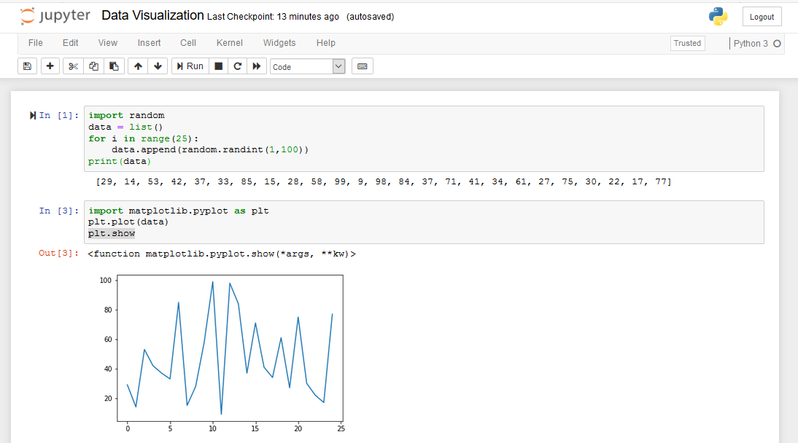
Some examples (data_visualization.ipynb)

Slide 54
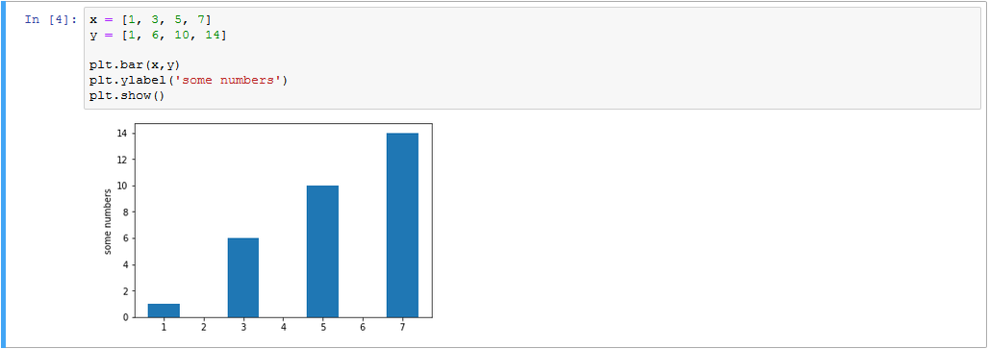
Some examples (data_visualization.ipynb)

Slide 55

Lab 5-c More programming with Python
Demystifying Computing with Python

Slide 56
Lab session
Download the questions in your local machine:
bddm-5-c-questions.ipynb
Either work on your VS Code with “csv preview” extension
Or upload the notebook to Google Colab
Solve the exercises up until 9 in class, as they will be commented.

